Slide 1
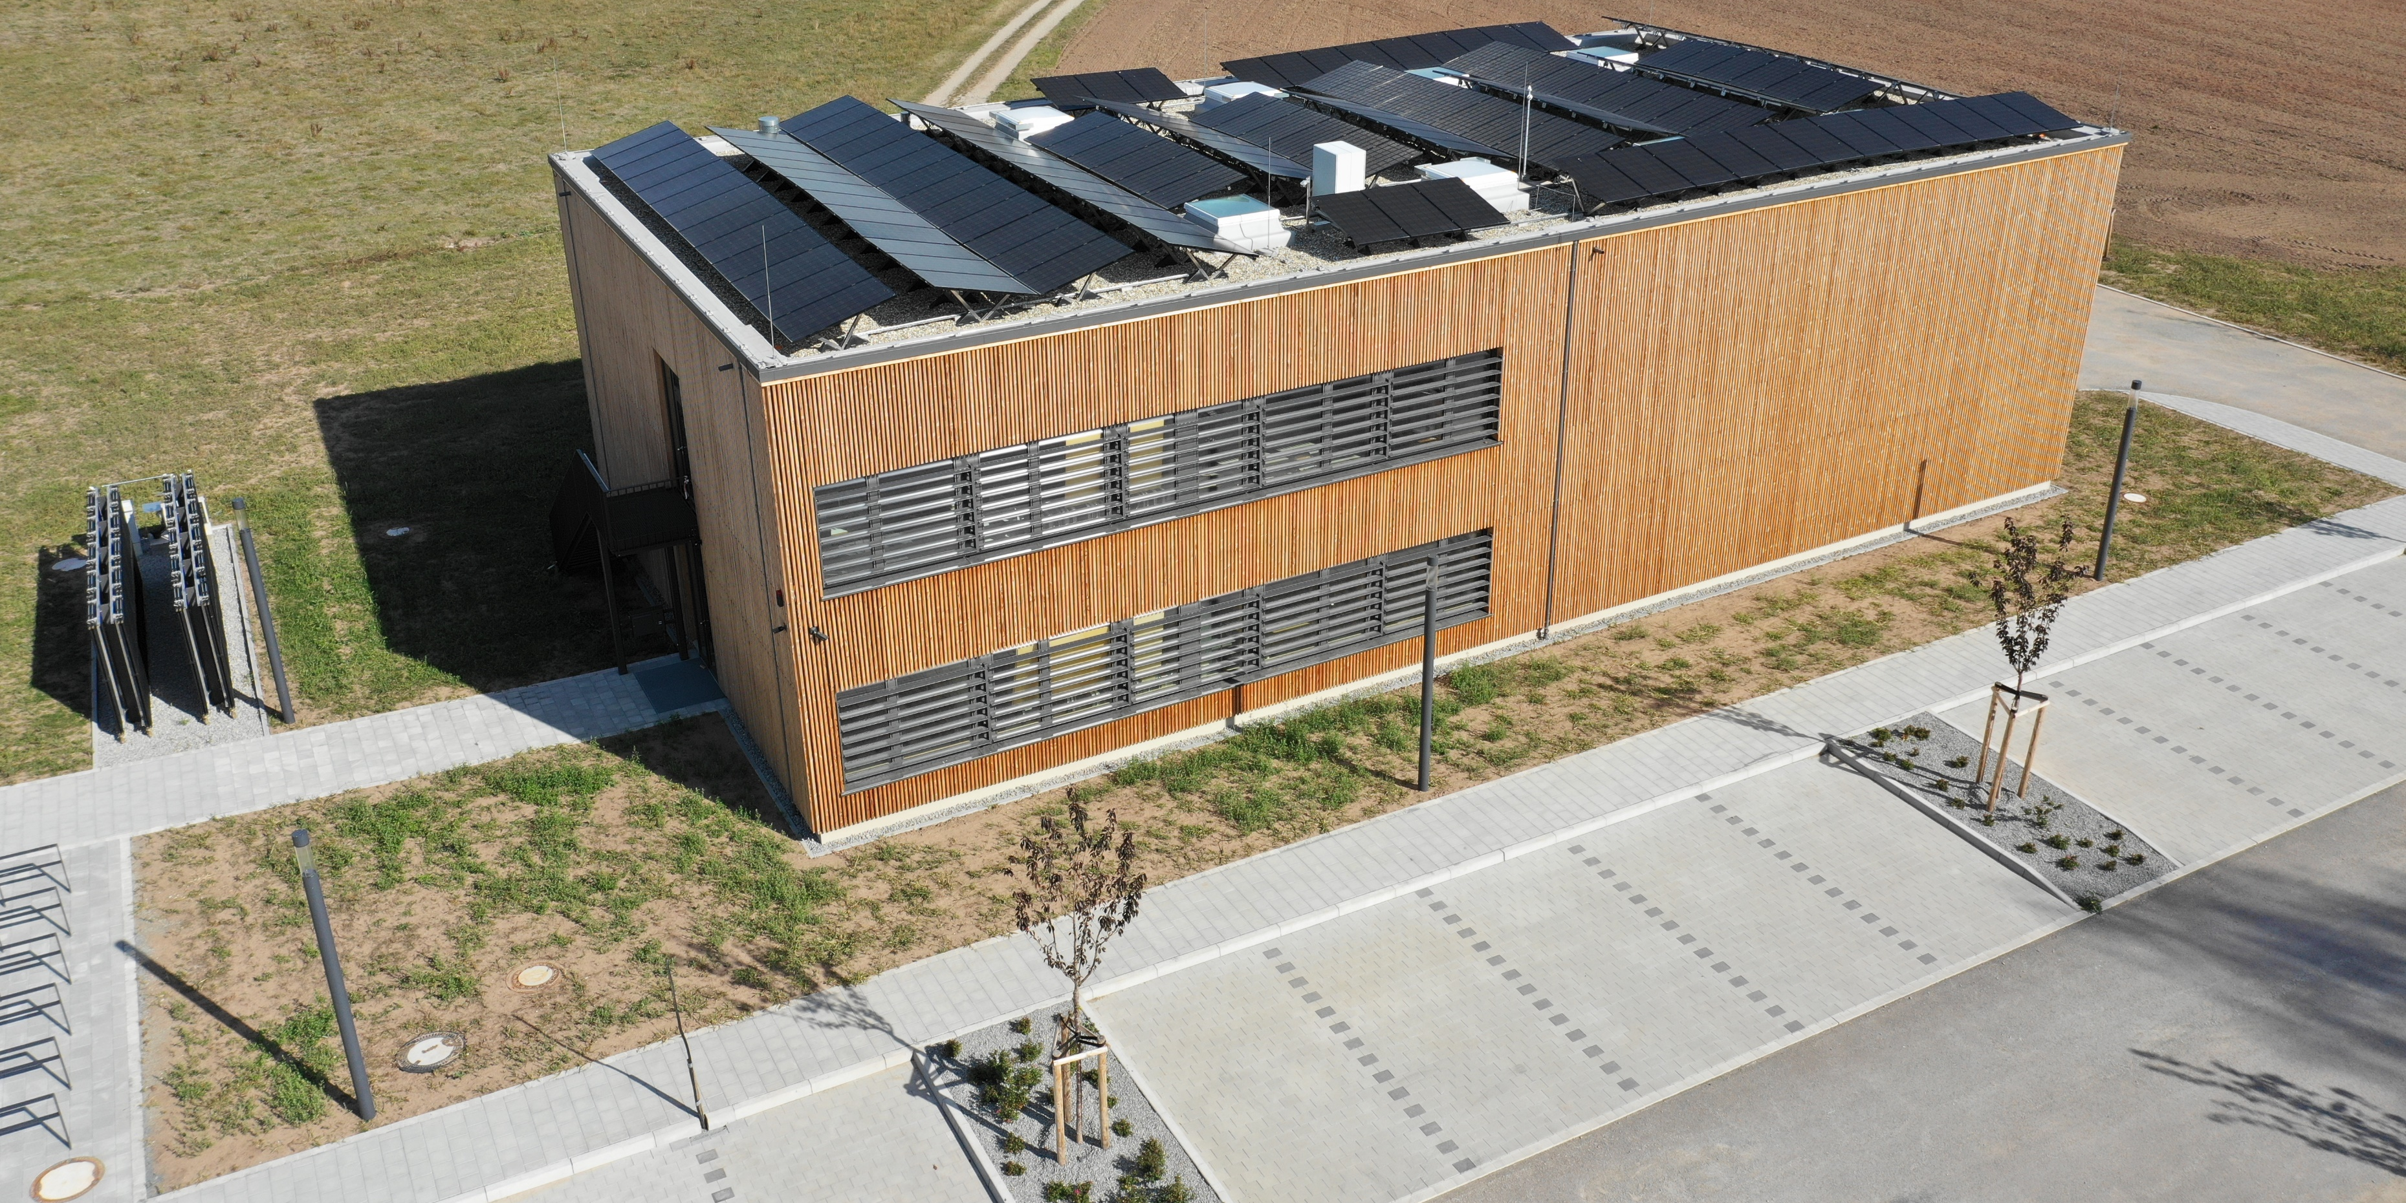
Projectwork in the subject Energy Management with AI Methods at the OTH Amberg Marco Obermeier – Master of Applied Research in Engineering Science Martikelnummer: 00165198 – Hochschule Ansbach

Slide 2
0. Taskunderstanding

Slide 3
0. Taskunderstanding
System Design of a cross-sectoral energy system for heating of a city in southern Germany:
Heat pump (air/water or water/water, cop based on temperature)
PV or solar thermal
Backup or peak load system
Large scale thermal storage (seasonal storage)
Connection to public grid
System Configuration (Oemof):
Component sizing (feasible component sizes)
Cost-optimized schedule (feasible schedule min/max up-downtimes)
CO2-optimized schedule
Cost-Calculation:
Yearly CAPEX-Costs
Yearly OPEX-Costs
Levelized-Costs of Energy

Slide 4
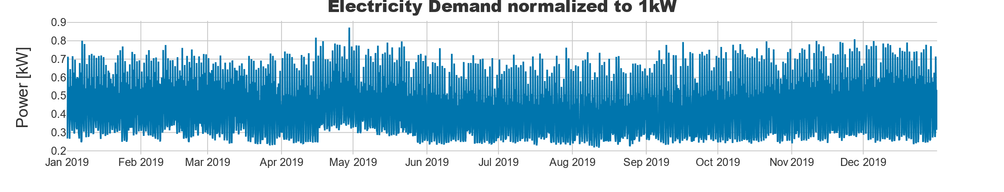
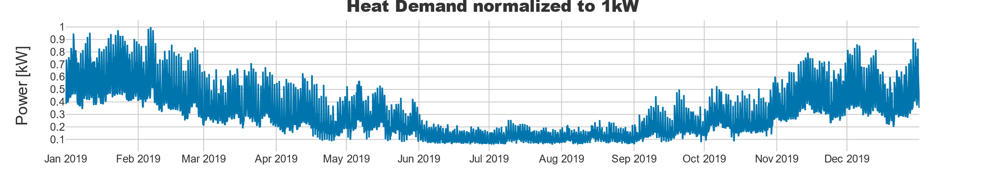
0. Given Data - Demands
Normalized Heat and Electricity Demands
Peakloads: Heat: 2500 kW, Electricity: 850 kW

Slide 5
1. System Design

Slide 6
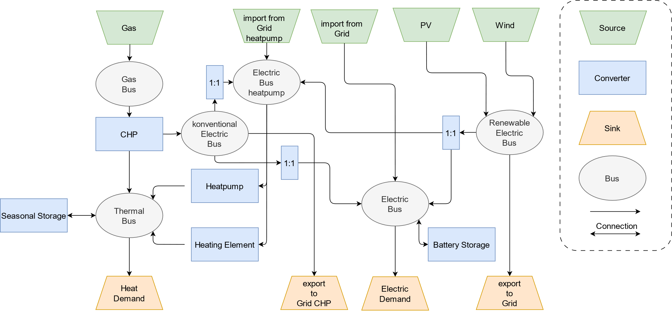
1. System Design
Specific Data: City: Weißenburg (49°01'53.5"N 10°57'54.0"E), database year: 2019
Backup and peak load system: Heating Element

Slide 7
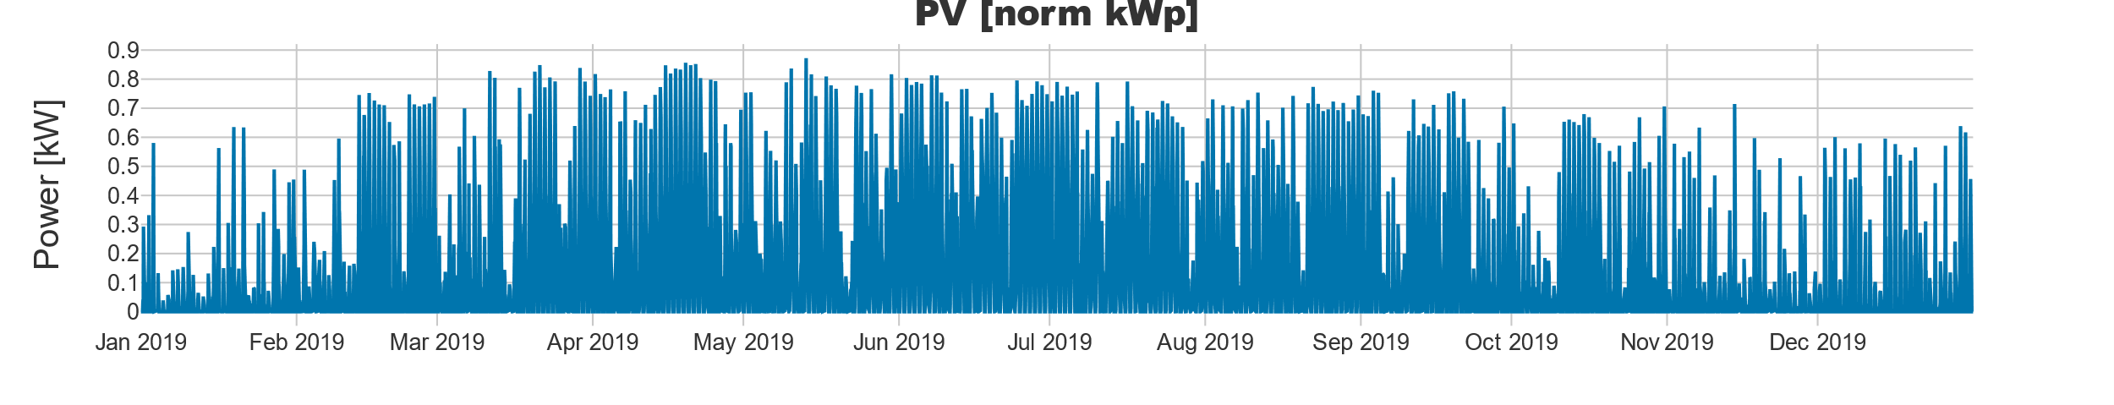
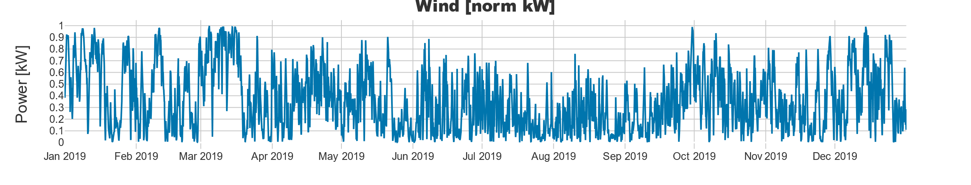
1. Researched Data - Renewables
Normalized PV (30 degree south - PV-Gis) and Wind Profiles (Renewables.ninja, merra2) of the year 2019

Slide 8
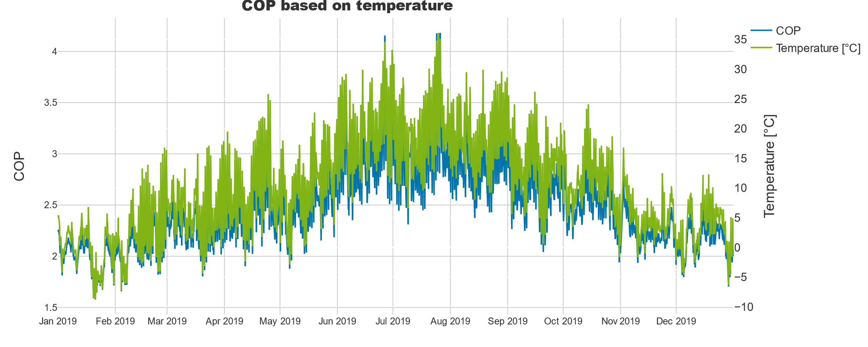
1. System Design: COP Heatpump
Calculate the COP based on the air temperature of the DWD-weather station 5440 of year 2019 (Weissenburg)

Slide 9
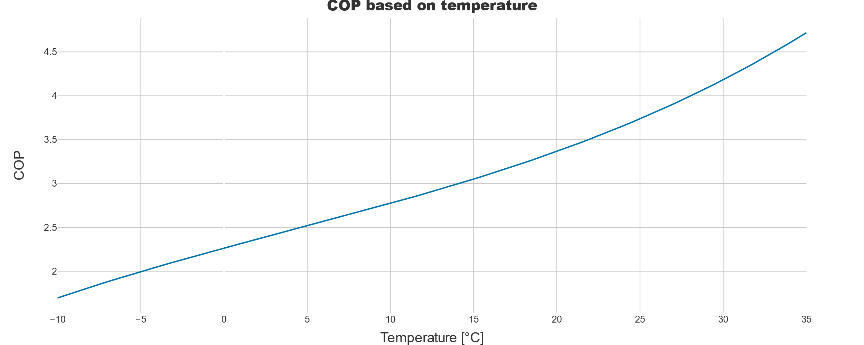
1. System Design: COP Heatpump
Set some example Datapoints (COP, Temperature) based on a datasheet of a heatpump
Calculate for each temperature the cop
Normalized the mean COP on the yearly used cop of a heatpump (not every heatpump offers data about temperature dependent cop)

Slide 10
2. System Configuration

Slide 11
2. System Configuration: Method
Investment optimization with oemof based on given and researched CAPEX and OPEX (cost optimized and co2 optimized)
Doing a research on the web to ensure that the calculated sizes are feasible
Set nominal values based on results of the investment optimization and the researched values (Set higher values for the backup system)
Run the Model as a cost optimized schedule
Run the Model as co2 optimized schedule (adding extra co2 costs to gas and grid and add a maximum constrain of co2)

Slide 12
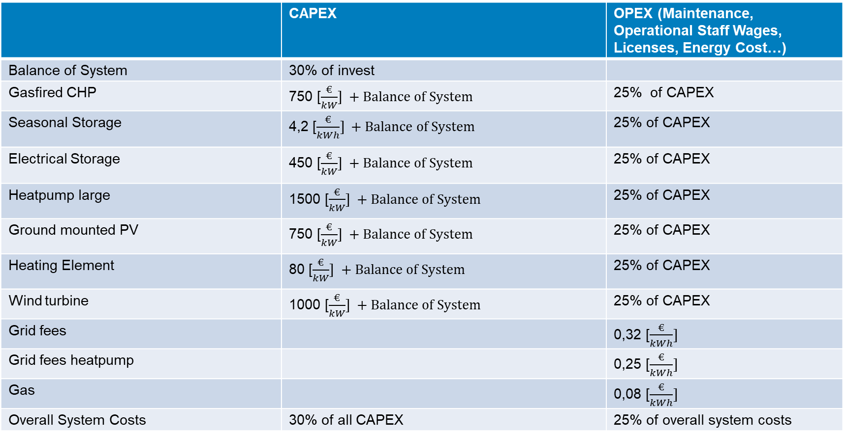
2. System Configuration: Cost assumptions
 | CAPEX | OPEX (Maintenance, Operational Staff Wages, Licenses, Energy Cost…)
Balance of System | 30% of invest
Gasfired CHP | 750 [$\frac{€}{kW}] +Balance of System$ | 25% of CAPEX
Seasonal Storage | 4,2 [$\frac{€}{kWh}] +Balance of System$ | 25% of CAPEX
Electrical Storage | 450 [$\frac{€}{kW}] +Balance of System$ | 25% of CAPEX
Heatpump large | 1500 [$\frac{€}{kW}] +Balance of System$ | 25% of CAPEX
Ground mounted PV | 750 [$\frac{€}{kW}] +Balance of System$ | 25% of CAPEX
Heating Element | 80 [$\frac{€}{kW}] +Balance of System$ | 25% of CAPEX
Wind turbine | 1000 [$\frac{€}{kW}] +Balance of System$ | 25% of CAPEX
Grid fees |  | 0,32 [$\frac{€}{kWh}]$
Grid fees heatpump |  | 0,25 [$\frac{€}{kWh}]$
Gas |  | 0,08 [$\frac{€}{kWh}]$
Overall System Costs | 30% of all CAPEX | 25% of overall system costs

Slide 13
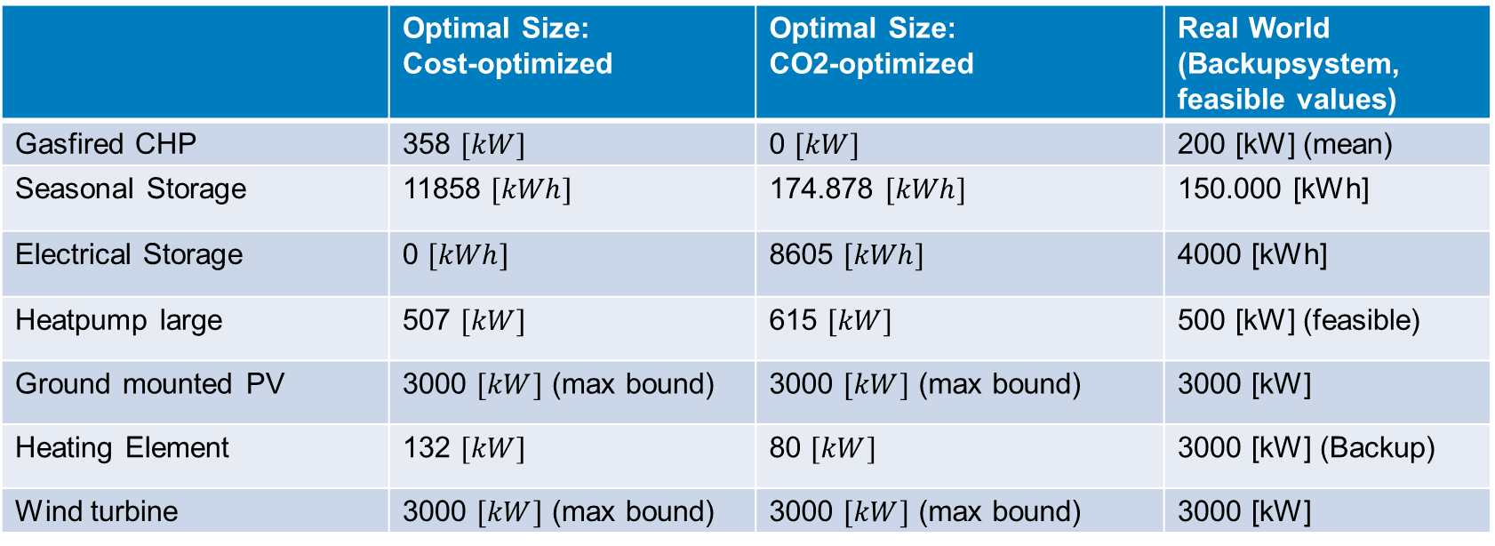
2. System Configuration: Optimal Size
 | Optimal Size: Cost-optimized | Optimal Size: CO2-optimized | Real World (Backupsystem, feasible values)
Gasfired CHP | 358 $[kW]$ | 0 $[kW]$ | 200 [kW] (mean)
Seasonal Storage | 11858 $[kWh]$ | 174.878 $[kWh]$ | 150.000 [kWh]
Electrical Storage | 0 $[kWh]$ | 8605 $[kWh]$ | 4000 [kWh]
Heatpump large | 507 $[kW]$ | 615 $[kW]$ | 500 [kW] (feasible)
Ground mounted PV | 3000 $[kW]$ (max bound) | 3000 $[kW]$ (max bound) | 3000 [kW]
Heating Element | 132 $[kW]$ | 80 $[kW]$ | 3000 [kW] (Backup)
Wind turbine | 3000 $[kW]$ (max bound) | 3000 $[kW]$ (max bound) | 3000 [kW]
Calculated with Python Package Oemof

Slide 14
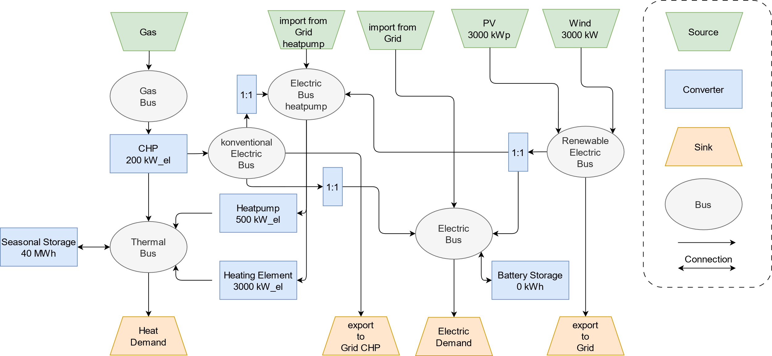
2. System Configuration: Result
Renewables (Wind and PV) run into maximum investment bound

Slide 15
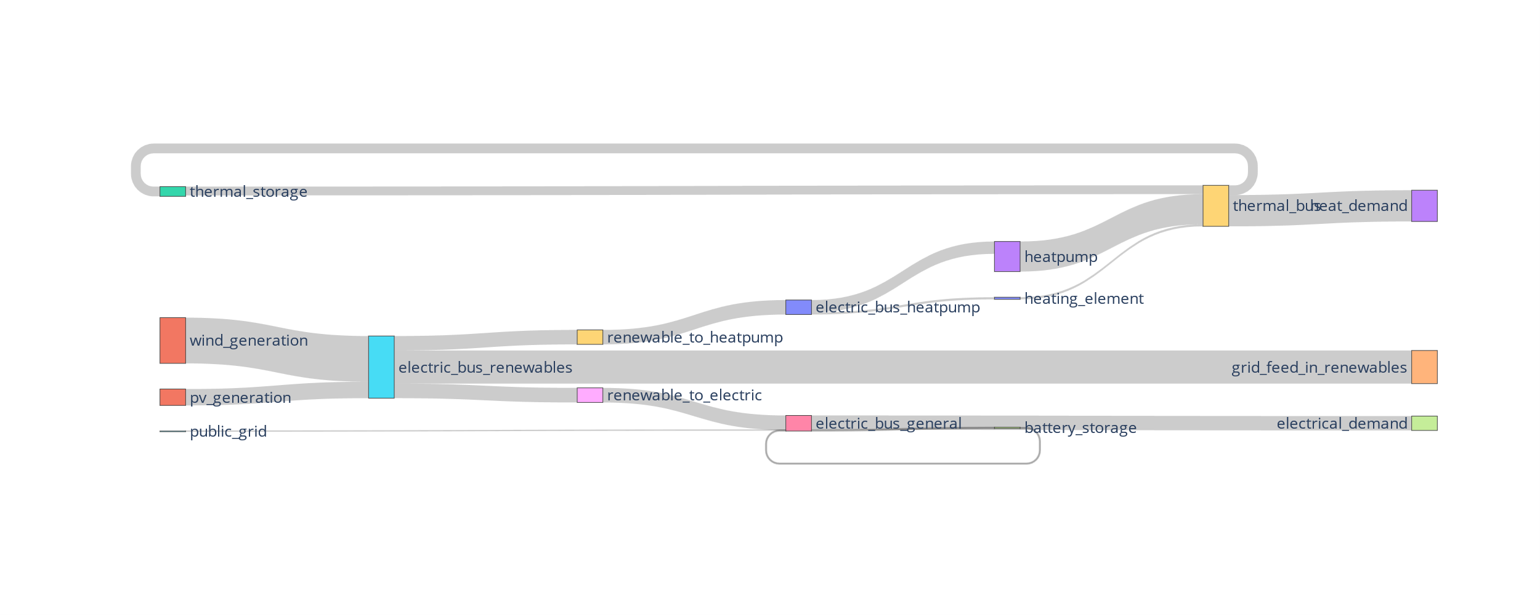
2. System Configuration: CO2-Optimized
CO2-optimized schecdule don’t uses gas

Slide 16
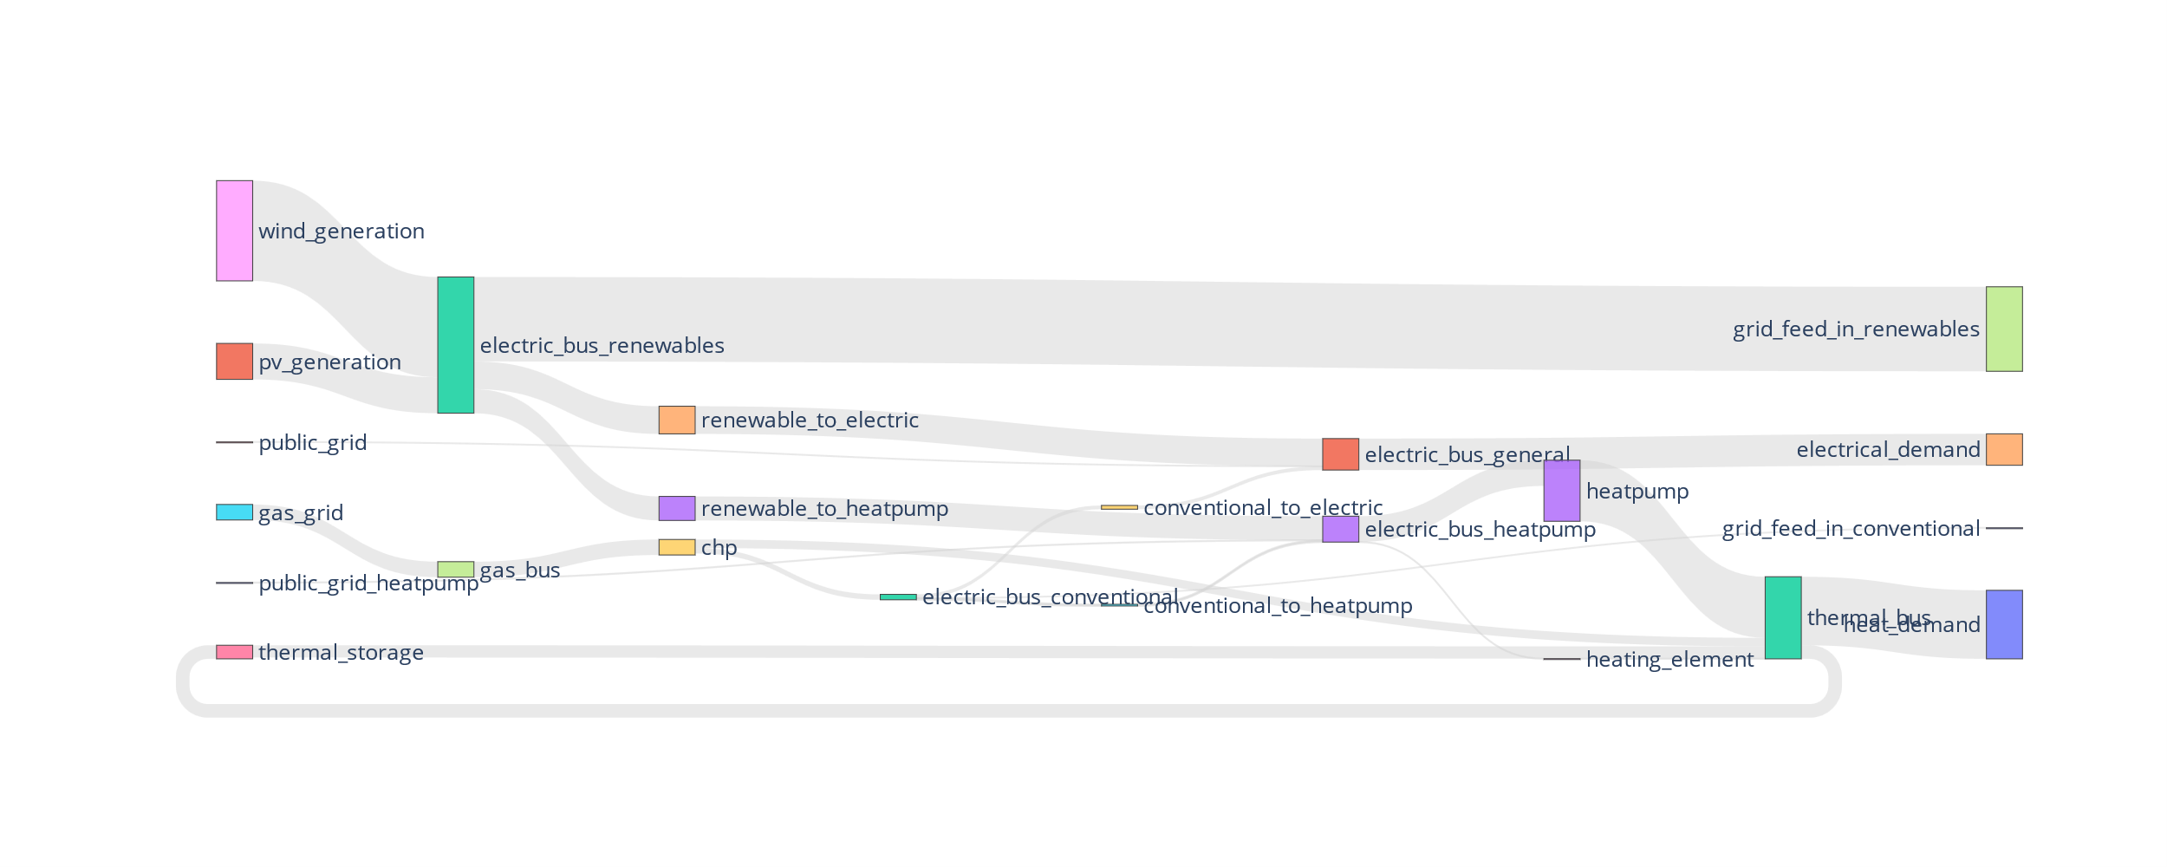
2. System Configuration: Cost Optimized
The cost optimized configuration using gas

Slide 17
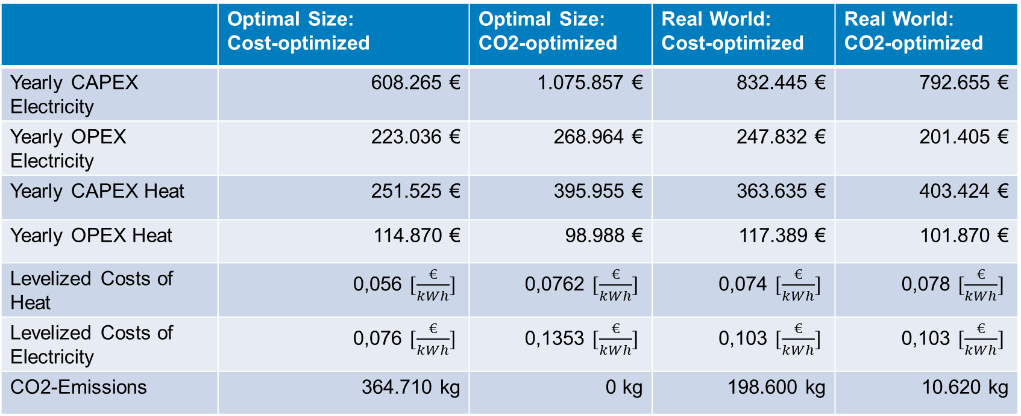
3. Cost Calculation:
 | Optimal Size: Cost-optimized | Optimal Size: CO2-optimized | Real World: Cost-optimized | Real World: CO2-optimized
Yearly CAPEX Electricity | 608.265 € | 1.075.857 € | 832.445 € | 792.655 €
Yearly OPEX Electricity | 223.036 € | 268.964 € | 247.832 € | 201.405 €
Yearly CAPEX Heat | 251.525 € | 395.955 € | 363.635 € | 403.424 €
Yearly OPEX Heat | 114.870 € | 98.988 € | 117.389 € | 101.870 €
Levelized Costs of Heat | 0,056 $[\frac{€}{kWh}]$ | 0,0762 $[\frac{€}{kWh}]$ | 0,074 $[\frac{€}{kWh}]$ | 0,078 $[\frac{€}{kWh}]$
Levelized Costs of Electricity | 0,076 $[\frac{€}{kWh}]$ | 0,1353 $[\frac{€}{kWh}]$ | 0,103 $[\frac{€}{kWh}]$ | 0,103 $[\frac{€}{kWh}]$
CO2-Emissions | 364.710 kg | 0 kg | 198.600 kg | 10.620 kg

